Slide 1





Create a
Movie
Recommendation
System

Slide 2










Team members
ARWA ABOU-ATTIA
HABIBA MOSTAFA
BASMALLA AYMAN
KARIM NASSER
AHMED SAMIR
KHALED ABOU-ELATTA

Slide 3







SPECIAL GREETINGS TO:
Dr. Sayed Haggag

Slide 4

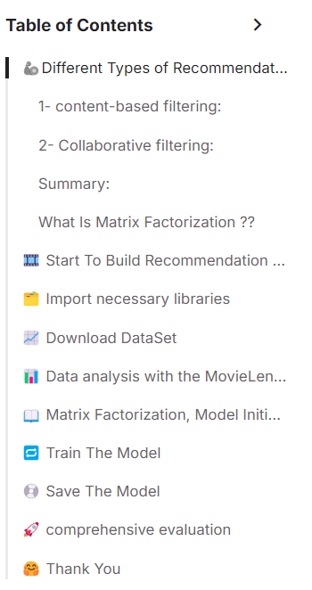

contents
1
Talking About Recommendation systems
2
About code
3
Deployment

Slide 5

Talking about
Movie
Recommendation
System

Slide 6





Recommendation
System
In the realm of machine learning, three predominant techniques for constructing recommendation engines are :
Content-based filtering.
Collaborative filtering.
Hybrid filtering.

Slide 7



1- content-based filtering:
This method generates suggestions based on items you have previously liked. It uses historical data such as purchase records and search history to identify similar products.
For example, if you rated the movie "Inception" with five stars, the system will recommend similar movies such as "Interstellar".
However, if all recommendation systems solely relied on your viewing history, discovering new genres and films would be challenging. This is where Collaborative filtering comes into play. But what exactly does it entail?.

Slide 8
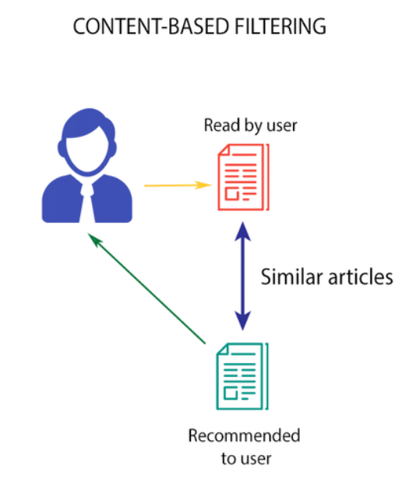

Slide 9
2- Collaborative filtering:
This method identifies other users who have similar preferences to you, and recommends items based on their choices.
For example, if you and your friend both like the movie "The Shawshank Redemption", and your friend also likes "Forrest Gump", the system will recommend "Forrest Gump" to you.

Slide 10
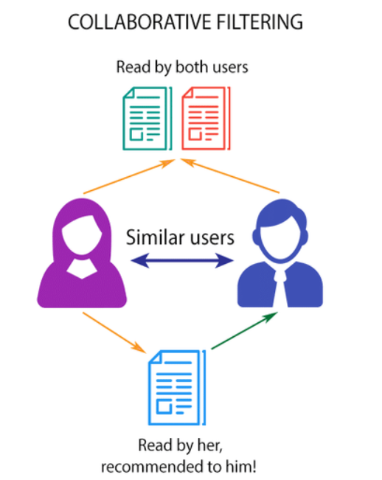
2- Collaborative filtering:

Slide 11
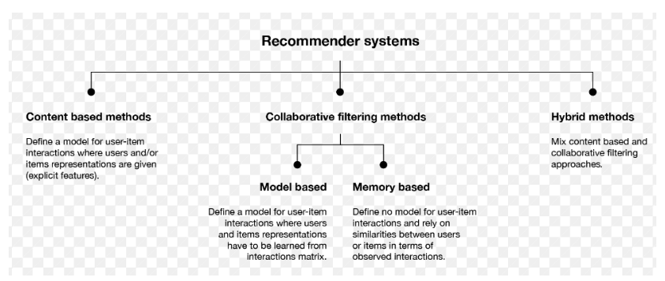
Recommendation
System

Slide 12


Our system
We are going to attempt to create a Recommendation Systems based on collaborative filtering using matrix factorization to get all my embeddings straight and then I'm going to top it off with a k-means clustering algorithm to get my prediction to see in general how well i have done collaborative filtering .

Slide 13
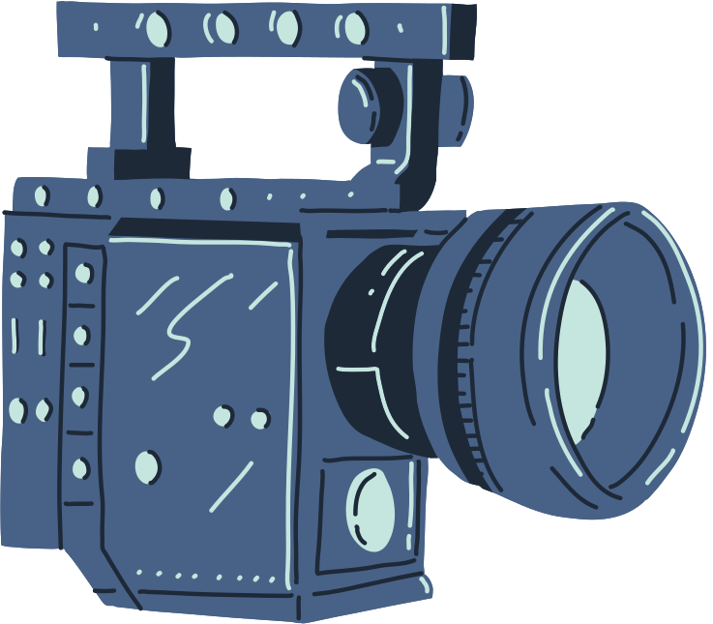
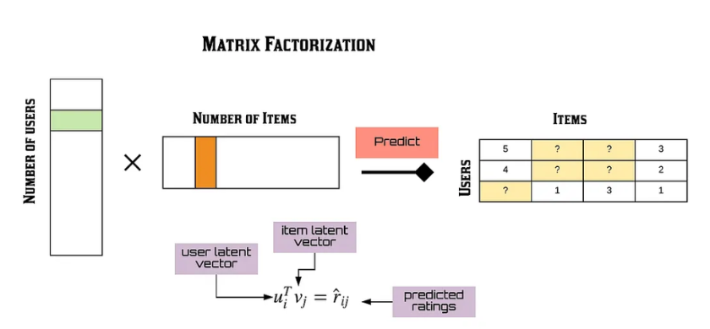
matrix factorization

Slide 14

Build
Recommendation
Systems

Slide 15
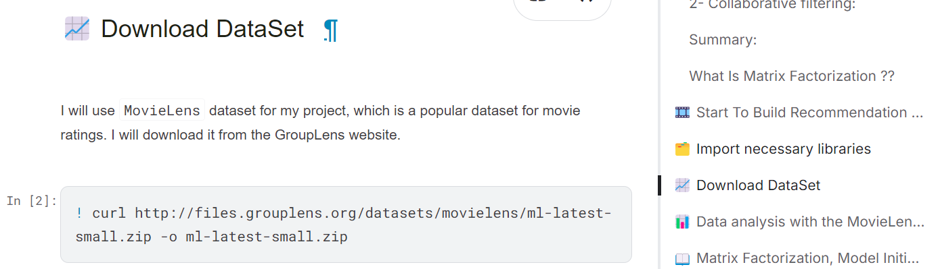

DataSet

Slide 16
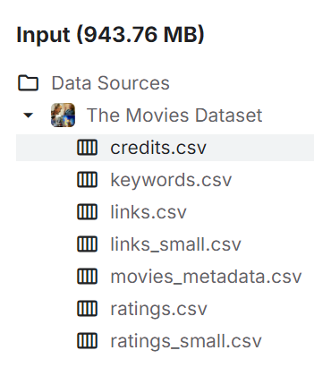


ratings.csv
movies.csv

Slide 17

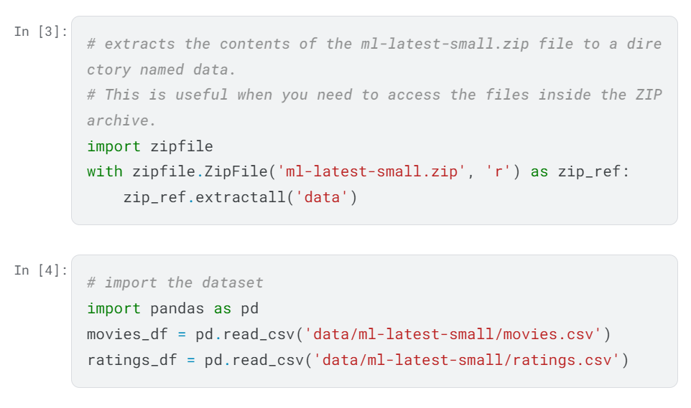



Slide 18
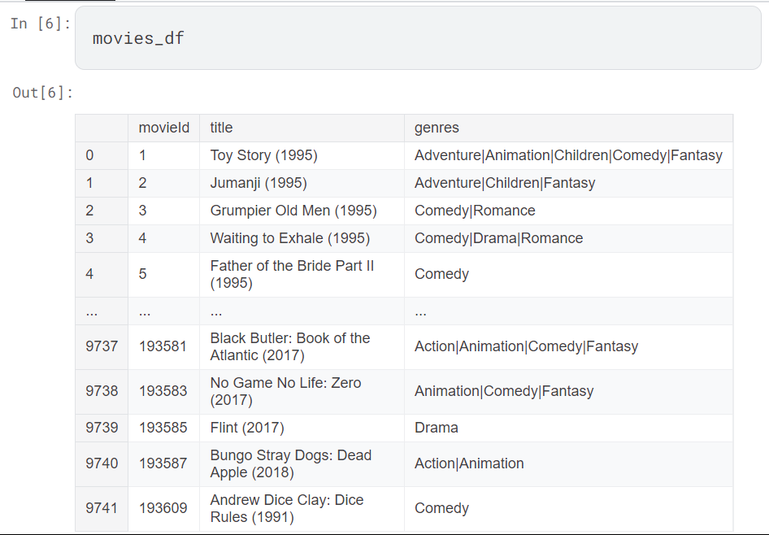
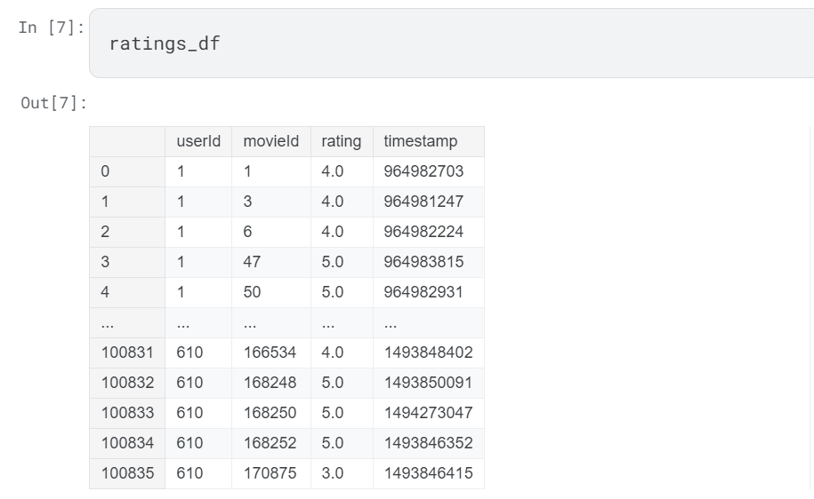
DataSet
1
2

Slide 19

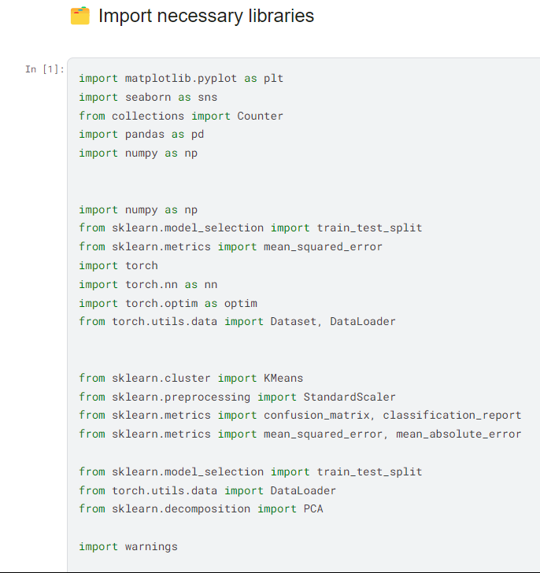
Pandas and Numpy: for data manipulation and analysis.
Seaborn and Matplotlib: for visualizing and analyzing data.
PyTorch: for creating deep models.
Scikit-learn: for matrix analysis and implementing algorithms like K-means.
Import necessary libraries

Slide 20

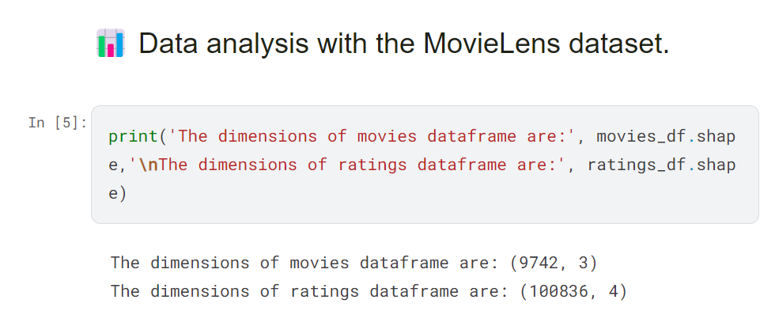
Data analysis

Slide 21

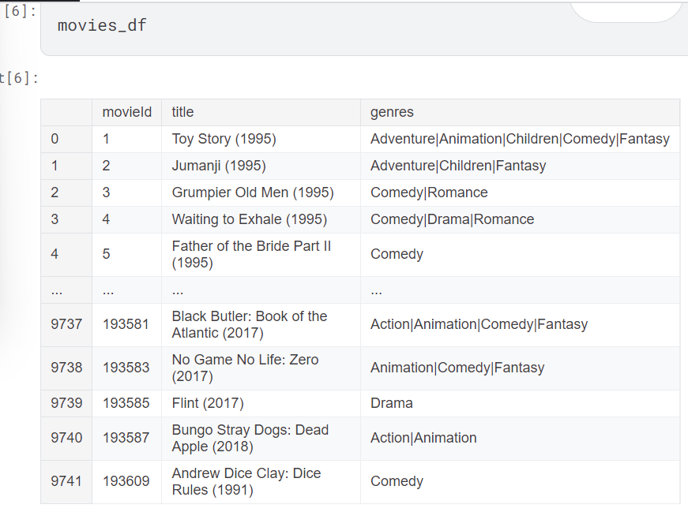
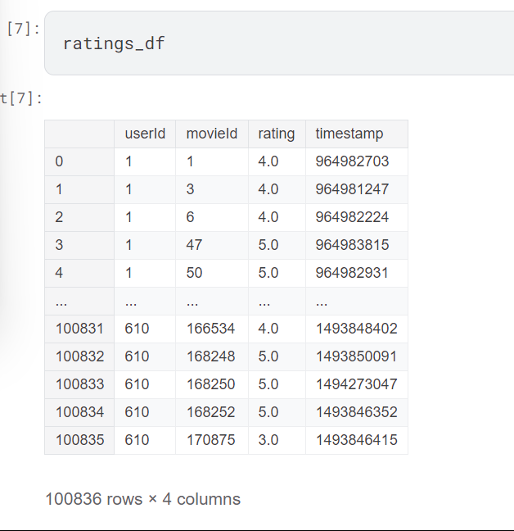

Slide 22
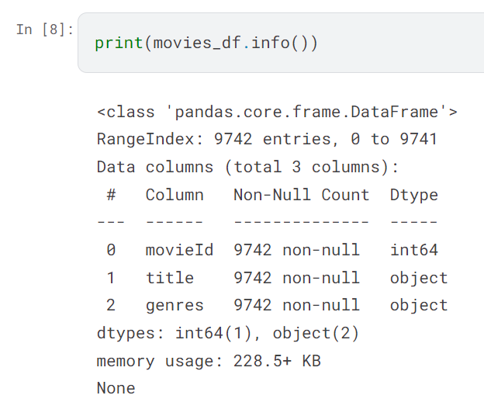
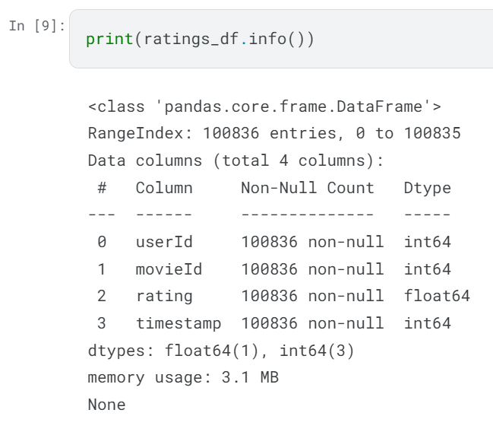
No null values

Slide 23
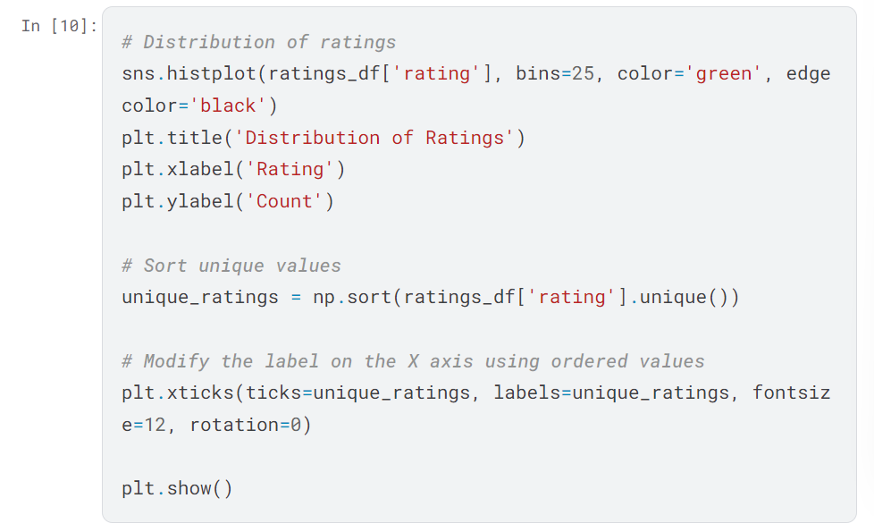
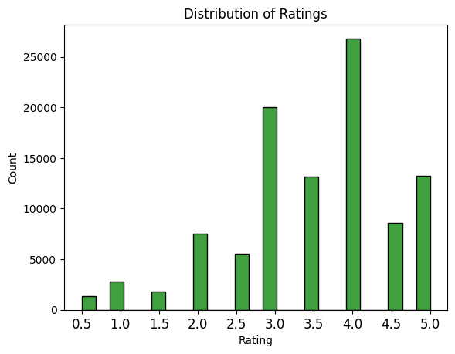

Slide 24
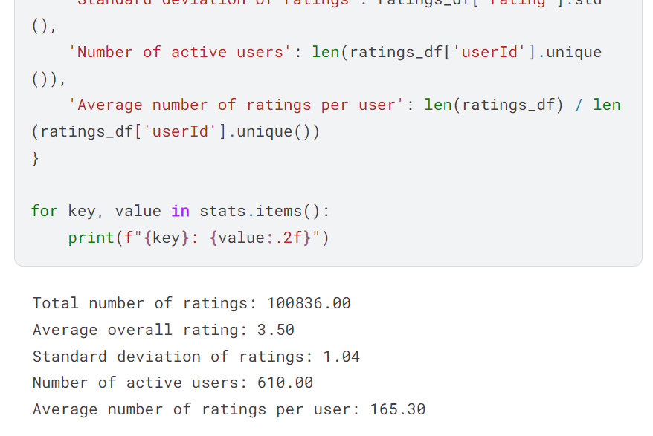

Slide 25
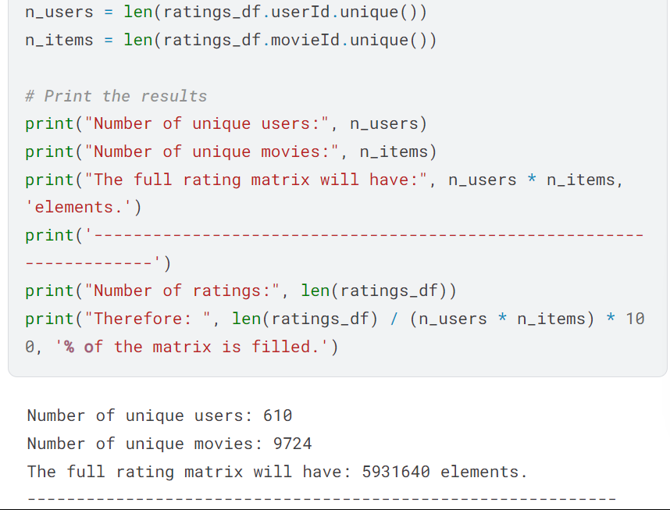

Slide 26

start to
Training Model

Slide 27
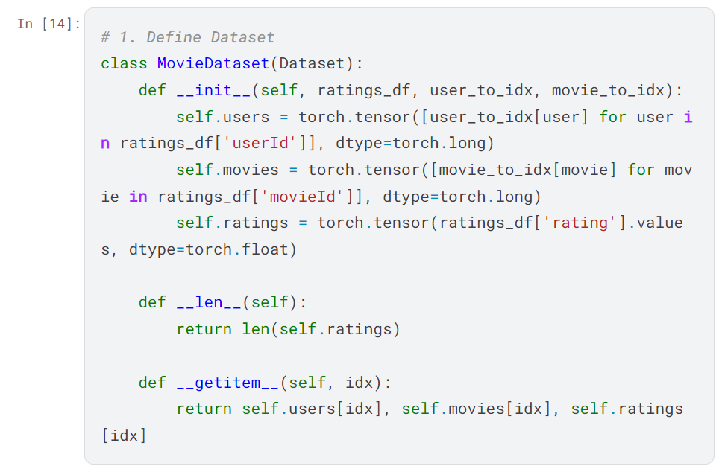

Dataset Class:
This part initializes the ratings database and converts it into a form that can be processed using PyTorch. It encodes user and movie IDs and converts ratings into tensors.

Slide 28

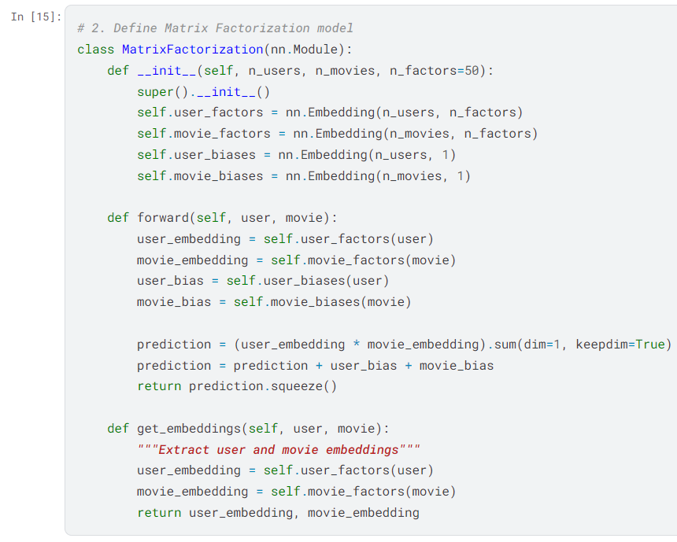
Building a collaborative filtering model:
The following part represents the mathematical model used to analyze matrices, where we rely on User & Item Embeddings to predict missing ratings:

Slide 29
How the model works:
Every time we pass in the “user ID” and the “movie”, we get the hidden vector for each. We use the inner product (Dot Product) of these vectors to predict the expected rating.

Slide 30
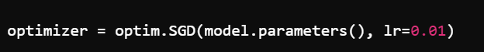

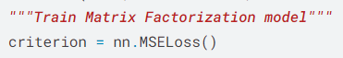
(Optimization Techniques)
We use the Stochastic Gradient Descent (SGD) algorithm to update the vectors based on the errors computed from the predictions:
We calculate the error between the predicted and actual valuation using a cost function such as MSE and then update the coefficients based on this error.

Slide 31
K-means Clustering :
After the matrix analysis and rating prediction are done, the K-means algorithm is used to cluster the movies based on the similarity in ratings. This helps in classifying the movies into groups that have similar characteristics based on the users’ preferences.

Slide 32

Summary of what was explained:
1
2
3
4
We used K-means to cluster movies based on similarity in ratings.
The large matrix was divided into smaller matrices representing user and movie preferences, with performance optimization techniques such as Gradient Descent used to improve accuracy.
The model was evaluated using MSE and MAE.
We used collaborative filtering based on matrix analysis to recommend movies.

Slide 33
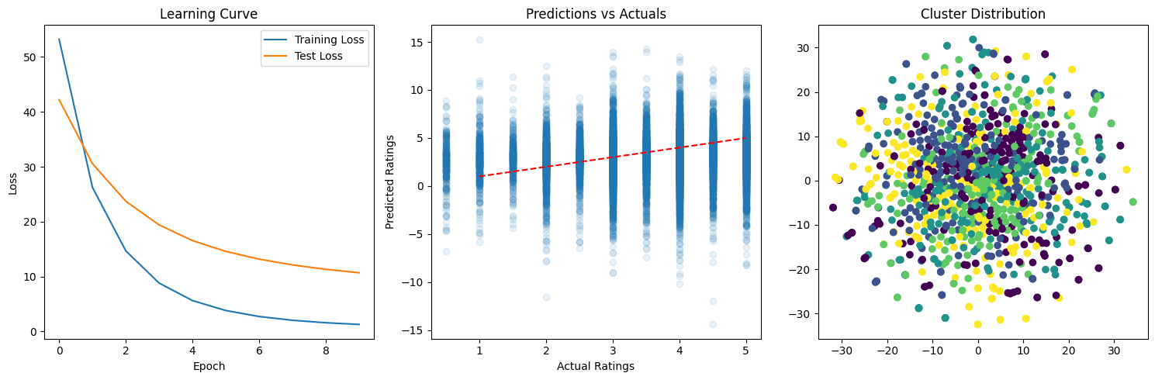

Slide 34

end of proj.
Model deployment

Slide 35
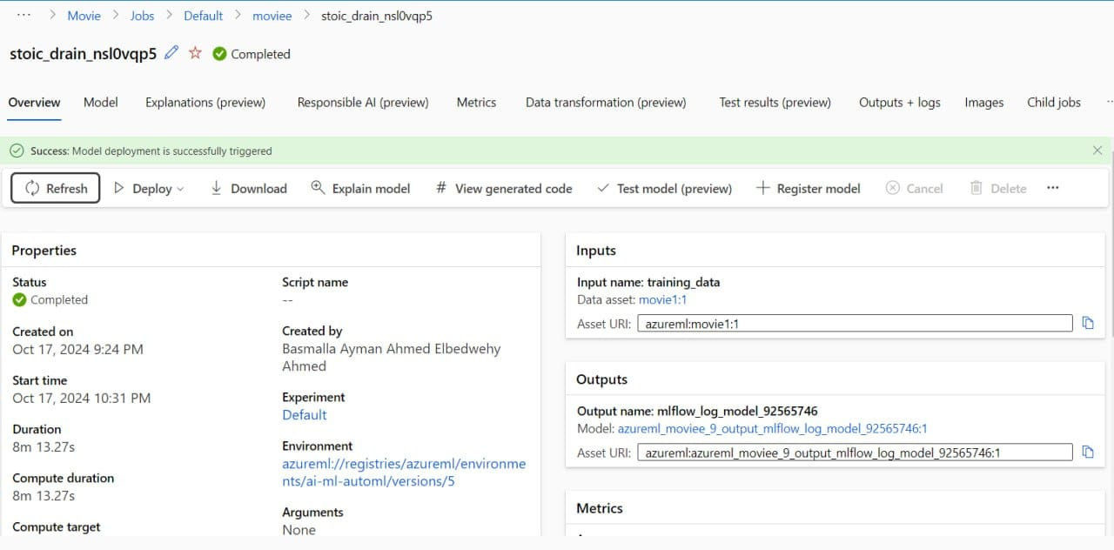

Slide 36
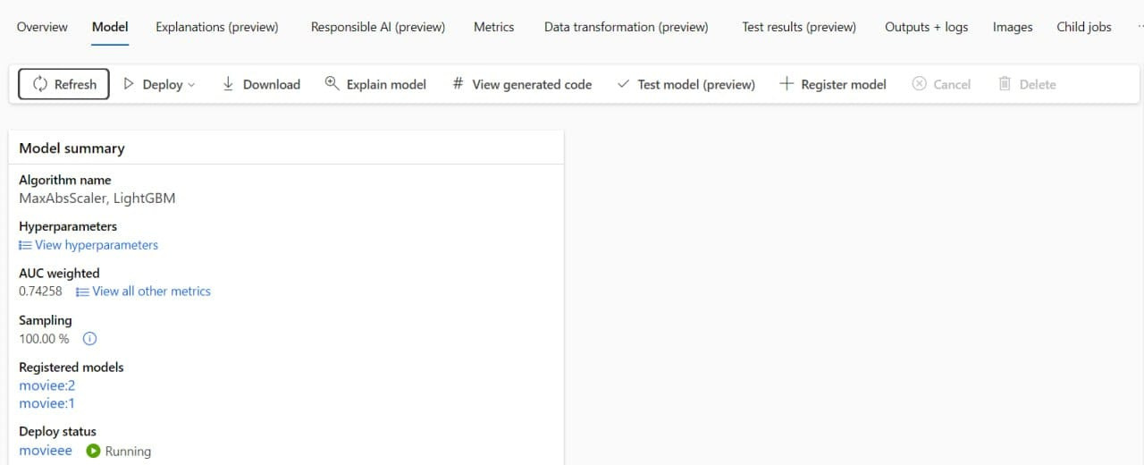

Slide 37

The End

